Slide 1
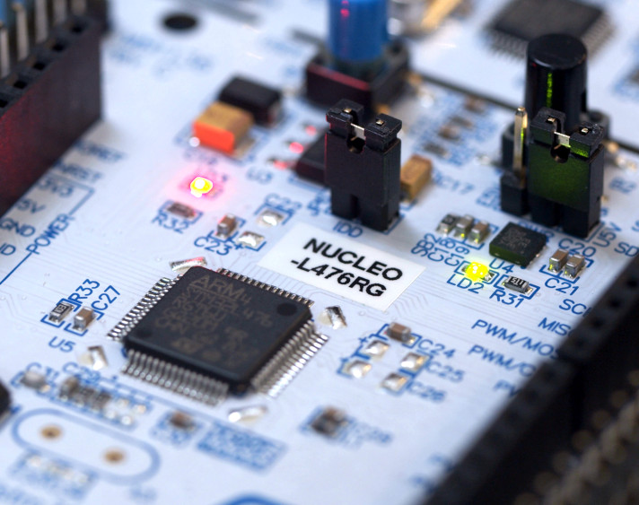
STM32 Development Board Basics
Dr. Shugata Ahmed
Assistant Professor
Department of Robotics and Mechatronics Engineering
University of Dhaka
Dhaka 1000, Bangladesh
Email: shugataahmed.rme@du.ac.bd

Slide 2

STM32F407G Discovery Board Features
Microcontroller: STM32F407G microcontroller has an ARM Cortex-M4 processor.
Memory: Flash memory (up to 1 MB), SRAM, as well as the ability to connect external memory devices.
Embedded ST-Link/V2 debugger onboard.
I/O ports: General Purpose I/O (GPIO) pins are connected to GPIO ports/ registers. Each port has 16 pins. For example: Port A has pins from PA0 to PA15.
Peripheral registers: GPIO registers, Flash interface register, UART registers, USART registers, Timer registers, etc. (See Table 1. of the reference manual)
Communication protocols: UART, USART, SPI, I2C.
Maximum operational frequency: 168MHz

Slide 3
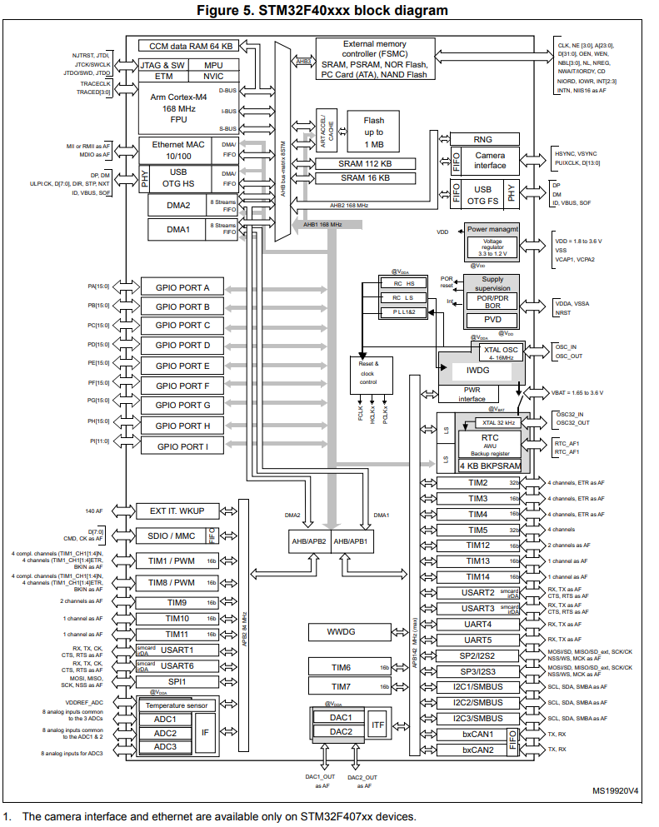
Bus
Advanced High-performance Bus (AHB): Maximum frequency 168MHz (HCLK), which is directly provided to the core memory, Direct Memory Access (DMA) and processor (FCLK).
All GPIO registers are connected to AHB1 bus.
Camera and USB are connected to AHB2 bus.
Advanced Peripheral Bus (APB):
APB1: Maximum frequency 42MHz (P1CLK). Connects to devices such as timers, USART pins, SPI pins, I2C pins, and CAN pins.
APB2: Maximum frequency 84MHz (P2CLK). Connects to devices such as timers, USART pins, ADC pins, and PWM pins.
AHB/APB1 and AHB/APB2 bridges are used to convert AHB protocol to APB protocol.

Slide 4
Dots show communication network between master and slave
AHB Bus Matrix
ICODE Bus is used to fetch instructions from the Flash memory to the CPU through AHB Bus Matrix and I-Bus (32-bit AHB-Lite Bus).
To be fetched the instruction must be stored in memory address 0x00000000 to 0x1FFFFFFC (in decimal from 0 to 536870908). (From ARM Cortex M4 Reference Manual)
DCODE Bus is used to fetch data and debug access from the Flash memory to the CPU through AHB Bus Matrix and D-Bus (32-bit AHB-Lite Bus).
To be fetched the instruction must be stored in memory address 0x00000000 to 0x1FFFFFFF (in decimal from 0 to 536870911). (From ARM Cortex M4 Reference Manual).
S-Bus (32-bit AHB-Lite Bus) is used to fetch instructions as well as data and debug accesses from locations outside of above addresses (0x20000000 to 0xDFFFFFFF and 0xE0100000 to 0xFFFFFFFF). (From ARM Cortex M4 Reference Manual). That means fetching instruction, data, and debug accesses from all other peripherals is by S-bus.
Master
Slave

Slide 5
Flash memory addresses
Flash memory address is from 0x08000000 to 0x080FFFFF (in decimal from 134217728 to 135266303) which is 1 MB.

Slide 6
Memory map
Width of the System bus (S-Bus) is 32 bit which can access 2^32 memory locations (memory address from 0x00000000 to 0xFFFFFFFF).
These memory addresses are assigned to different peripheral registers.
For memory map of different registers, see Table 1 of the reference manual.

Slide 7
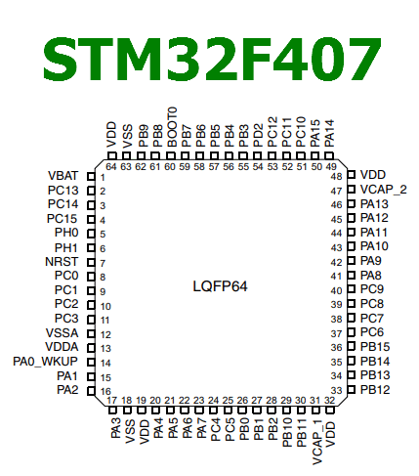
Clocks
Clock sources:
External source/ Crystal oscillator : Connected externally to the MCU. Hence it is called High Speed External (HSE) oscillator source. For STM32F407G MCU the HSE frequency must be between 4-20 MHz. In STM32F407G Discovery Board an 8 MHz oscillator is connected between PH0 and PH1 pins of the MCU. Nucleo boards does not have the on-board crystal oscillator. Clock signal is provided from the external source which is ST-Link circuitry.
RC oscillator : 16 MHz RC oscillator built-in inside the MCU. Hence it is called High Speed Internal (HSI) oscillator source. It is the default clock.
PLL (Phase Locked Loop) : Built-in inside the MCU. It boosts HSE or HSI clock.
Oscillator is connected between these pins
MCU pin out diagram

Slide 8
Task: Turning On Built-in LEDs
Let’s turn on the green LED (LD4) step-by-step!

Slide 9
Enabling the clock
Clock for peripherals which are connected to AHB1 bus (such as GPIO ports, USB) are enabled by RCC AHB1 peripheral clock register (RCC_AHB1ENR).
For example, bit 3 of this register (GPIODEN) enables/ disables IO port D clock:
Base address:
0x4002 3800

Slide 10
Setting I/O pins as input/ output
It is done by GPIO port mode register (GPIOx_MODER) (x = A..I/J/K)
For example, PD12 can be declared as an output pin by setting bit 25 and 24 as 0 and 1, respectively.
Base address:
0x4002 0C00

Slide 11
Making output pin high
It is done by GPIO port output data register (GPIOx_ODR) (x = A..I/J/K)
For example, PD12 can be made high by setting bit 12 as 1.
The reserved bits (16-31) must be kept 0.
Base address:
0x4002 0C00

Slide 12
Macros in C
Our Code to Define Macros for Register Addresses
#define RCC_AHB1_ENR_OFFSET 0x30
#define RCC_BASE_ADDR 0x40023800
#define RCC_AHB1_ENR_ADDR (RCC_BASE_ADDR+RCC_AHB1_ENR_OFFSET)
#define GPIOD_MODER_REG_OFFSET 0x00
#define GPIOD_BASE_ADDR 0x40020C00
#define GPIOD_MODER_REG_ADDR (GPIOD_BASE_ADDR+GPIOD_MODER_REG_OFFSET)
#define GPIOD_ODR_OFFSET 0x14
#define GPIOD_ODR_ADDR (GPIOD_BASE_ADDR+GPIOD_ODR_OFFSET)

Slide 13
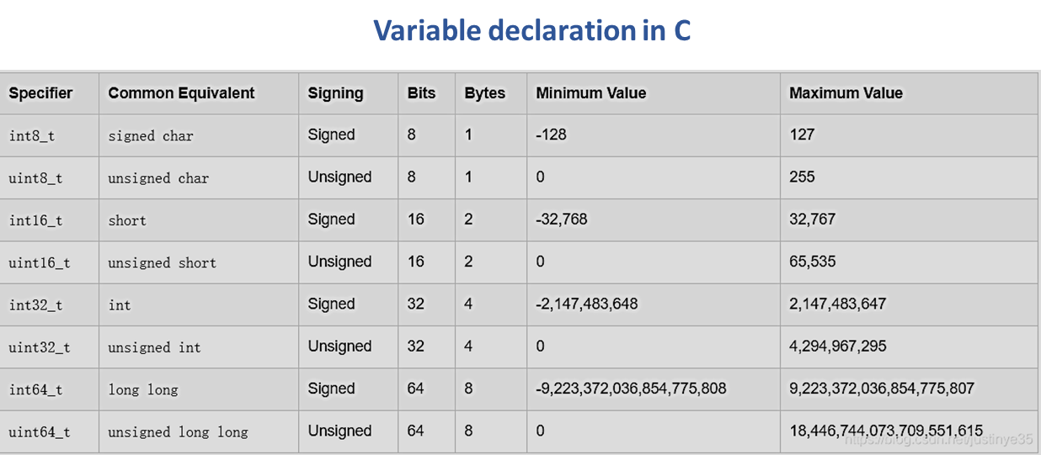
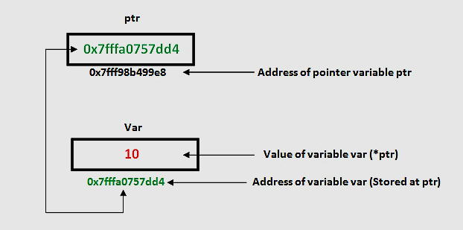
Pointer in C
Our Code to Declare Pointers
Our Code to Set Register Values
uint64_t *pGpiodModerReg = (uint64_t*) GPIOD_MODER_REG_ADDR;
uint64_t *pRccAhb1EnrReg = (uint64_t*) RCC_AHB1_ENR_ADDR;
uint64_t *pGpiodOdrReg = (uint64_t*) GPIOD_ODR_ADDR;
*pRccAhb1EnrReg=0x8;
*pGpiodModerReg=0x1000000;
*pGpiodOdrReg=0x1000;

Slide 14
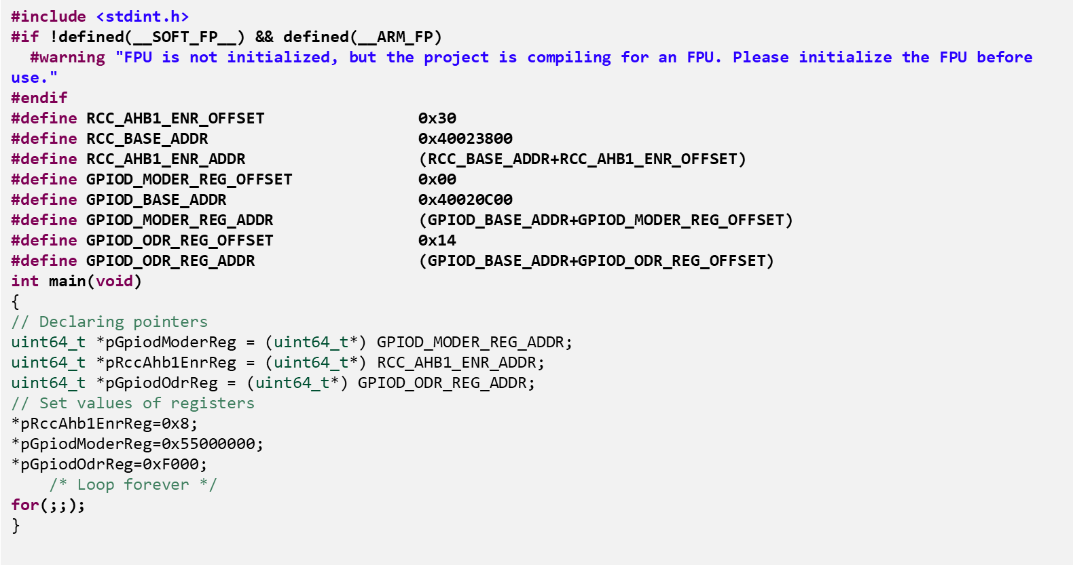
Final Code

Slide 15
Programming steps
Write the code in the source file
Build project
Debug
Build project: To compile source code from one or more files and then link those files into an executable file.

Slide 16
Tool chain
A tool-chain is a set of programs which are used to develop, compile, debug and monitor an application.

Slide 17
Cross compiler
Runs on one architecture but produces code for different architecture.
GNU ARM Cross-compiler converts code to executable and linkable file (.elf) or binary file (.bin, .hex).

Slide 18
Debugger
GDB, the GNU Project debugger, allows you to see what is going on `inside' another program while it executes -- or what another program was doing when it crashed.
GDB functions:
Start your program, specifying anything that might affect its behavior.
Make your program stop on specified conditions.
Examine what has happened, when your program has stopped.
Change things in your program, so you can experiment with correcting the effects of one bug and go on to learn about another.

Slide 19
Task: Providing Input Signal from a Motion Sensor and Turn On All Built-in LEDs in Response to That
Let’s provide an input signal from a motion sensor connected to the PE0 pin and turn on the Green LED (LD4), Orange LED (LD3), Red LED (LD5), and Blue LED (LD6) in response to that!

Slide 20
Enabling the clock for GPIO ports
Bit 3 (GPIODEN) of RCC AHB1 peripheral clock register (RCC_AHB1ENR) register enables/ disables IO port D clock.
Bit 4 (GPIOEEN) of RCC AHB1 peripheral clock register (RCC_AHB1ENR) register enables/ disables IO port E clock.
Base address:
0x4002 3800

Slide 21
Enabling the clock for window watchdog
Bit 11 (WWDGEN) of RCC APB1 peripheral clock enable register (RCC_APB1ENR) register enables/ disables window watchdog clock.
Base address:
0x4002 3800

Slide 22
Setting I/O pins as input/ output
PE0 can be declared as an input pin by setting bit 1 and 0 of GPIOE_MODER register as 00 and PD12, PD13, PD14, PD15 can be declared as an output pin by setting bit 31 to 24 of GPIOD_MODER as 01010101.
Base address of port E:
0x4002 1000
Base address of port D:
0x4002 0C00

Slide 23
Pull down input pin
Bit 31 to 0 of GPIOE_PUPDR register as 10101010101010101010101010101010.
Base address:
0x4002 1000

Slide 24
Making output pins high
PD12, PD13, PD14, PD15 can be made high by setting bit 15 to 12 of GPIOD_ODR as 1111.
Base address:
0x4002 0C00

Slide 25
Providing software reset
It is done by Window watchdog control register (WWDG_CR).
A reset is triggered when the watchdog is enabled by making bit 7 (WDGA) of WWDG_CR 1 and setting bit 6 to bit 0 as 1000000.
The reserved bits (16-31) must be kept 0.
Base address:
0x4000 2C00

Slide 26
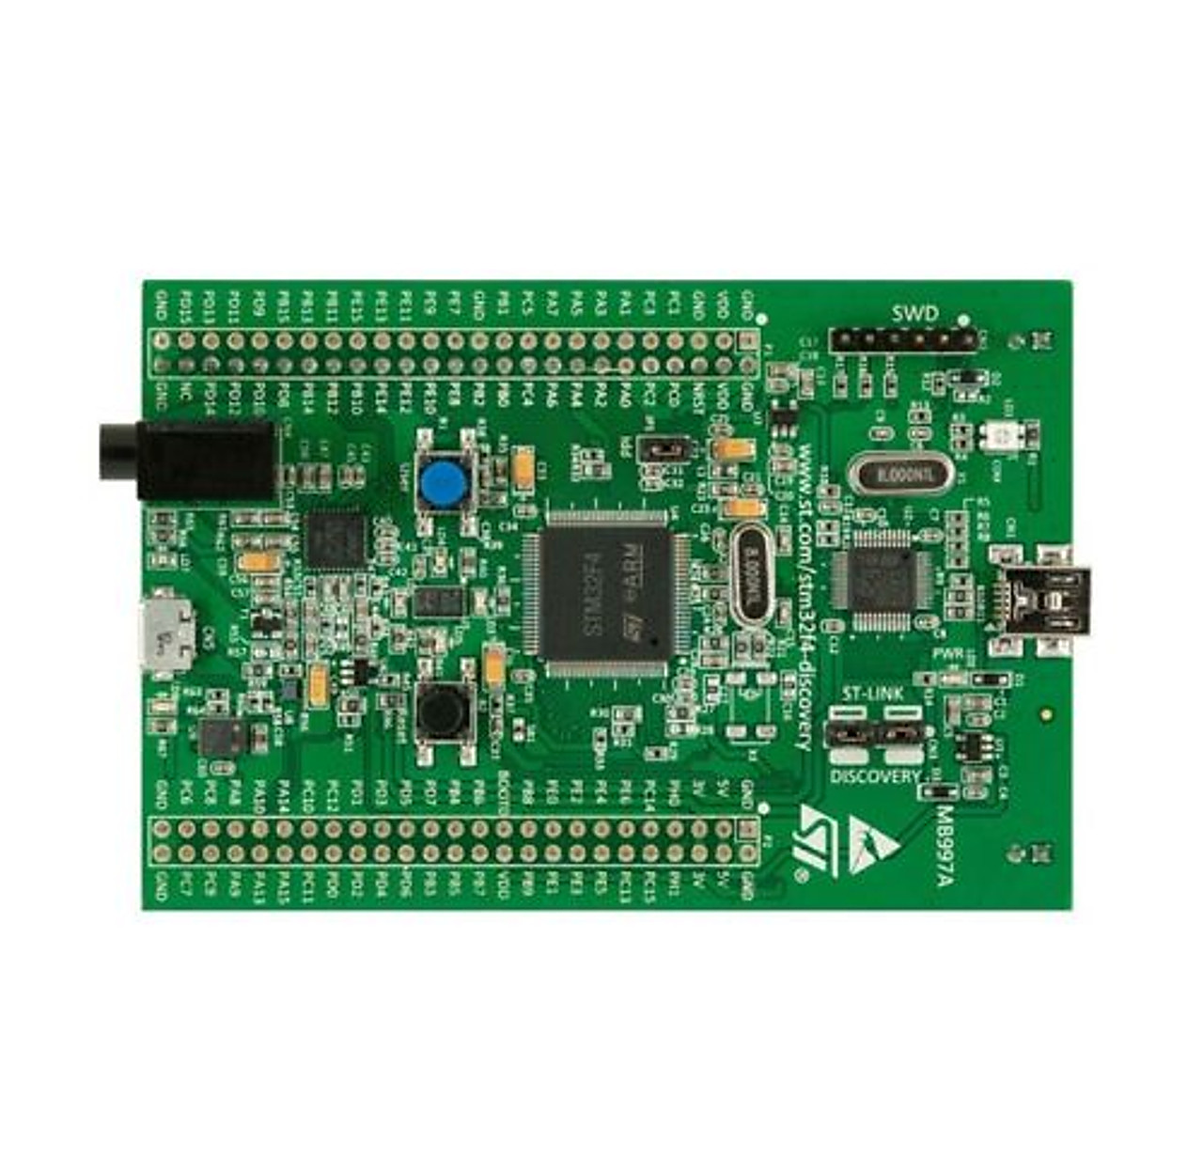
Task: Providing Interrupt Signal from Built-in Push Button
Let’s provide an interrupt signal from the B1 button (blue button in the development board) and turn on the Green LED (LD4) in response to that!

Slide 27
Vector table
Exception and interrupt are unexpected events that alter program flow.
An exception occurs inside the processor during program execution while an interrupt occurs outside of the processor.
When exception occurs, a hardware signal known as interrupt request (IRQ) is sent to the CPU to stop its current program execution and an exception handler (a function) is executed. Exception handlers are stored in ROM (Flash memory).
When interrupt occurs, Interrupt Service Routine (ISR)/ interrupt handler is executed. ISRs are stored in RAM.
The vector table shows memory addresses for different exception/ interrupt handlers. See Table 61 of the reference manual.
Exception handlers are defined in the startup file. Startup file is written in Assembly or C language.

Slide 28
Description of exception/ interrupt handlers
IRQ number
Priority of executing exception/ interrupt handlers
Address of exception/ interrupt handlers in the memory
IRQ number of exceptions are decided by the ARM manufacturer, not by the MCU manufacturer. Hence, these are empty.
Exceptions
Interrupts

Slide 29
External interrupt/ event line mapping
All the 0 and 1 pins are connected to the external interrupt controller SYSFG_EXTICR1.
The external interrupt controller is connected to the APB2 bus.
This register is connected to Nested Vector Interrupt Controller (NVIC) of the CPU through 23 IRQ lines.
All the pin 0s are connect with NVIC through IRQ line EXTI0.

Slide 30
EXTI line interrupts in the vector table

Slide 31
Controls interrupt delivery to the NVIC
Once interrupt is triggered, the CPU gets interrupt signal continuously even if the interrupt signal is no longer there. To stop the interrupt signal, this register must be cleared.
Needs to configure these registers to select whether we want to detect rising of falling edge of the input using edge detect circuit
Detects whether an input is rising or falling

Slide 32
Enabling the clock
Clock for peripherals which are connected to APB2 bus (such as External Interrupt Controller) are enabled by RCC APB2 peripheral clock enable register (RCC_APB2ENR).
For example, bit 14 of this register (SYSCFG EN) enables/ disables clock for System Configuration Controller:
The reserved bits must be kept 0.
Base address:

Slide 33
Configuring External Interrupt Controller
It is done by System configuration controller (SYSCFG).
To configure external interrupt controller SYSFG_EXTICR1, SYSCFG external interrupt configuration register 1 (SYSCFG_EXTICR1) is used.
For example, to select PA0 as the source of interrupt signal, the first 4 bits (bit 0 – bit 3) need to set 0000.
Base address:

Slide 34
Unmasking the Interrupt
It is done by Interrupt mask register (EXTI_IMR)
For example, interrupt signal from EXTI0 can be unmasked by making first bit (bit 0) as 1.
The reserved bits (23-31) must be kept 0.
Base address:

Slide 35
Detecting Rising Edge
It is done by Rising trigger selection register (EXTI_RTSR).
For example, rising trigger of input line 0 for EXTI0 can be enabled by setting the first bit (bit 0) as 1.
The reserved bits (23-31) must be kept 0.
Base address:

Slide 36
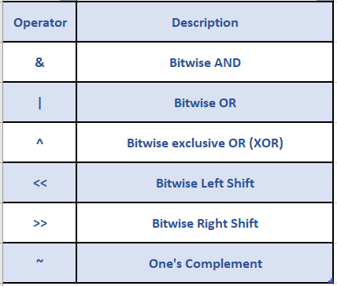
Bitwise operators in C

